Slide 1

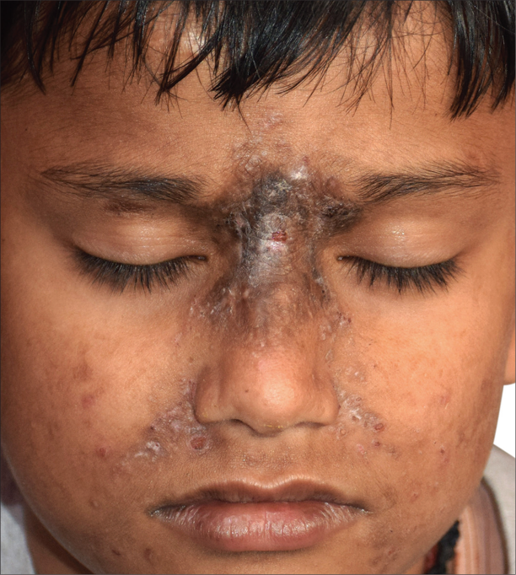
Midface Toddler Excoriation Syndrome (MiTES)
Less severe form of Hereditary Sensory – Autonomic Neuropathy type 8.
Characterized by chronic, self- inflicted excoriations of the midface, often leading to significant scarring & hyperpigmentation.
Typically affects young children, with a male predominance.
Linked to Autosomal Recessive biallelic mutations in PRDM 12 gene.
Treatment approach: Topical antimicrobials, Emollients, Steroids & oral medications aimed at reducing scratching impulses.
Lichenified plaque on the bridge of the nose along with excoriation marks and atrophic scarring of the midface
Ref: Patel V, Yadav D et al. Midface Toddler Excoriation Syndrome (MiTES): A Review. Pediatr Dermatol. 2025 May – Jun; 42 (3):469-474.
IADVL – AP
TEAM NELLORE

