Slide 1

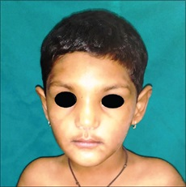
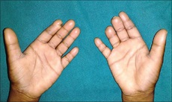
Rubinstein – Taybi Syndrome
(Broad thumb – hallux syndrome)
Occur sporadically due to mutations in the gene encoding CAMP responsive element binding protein (CREBP) located on 16p13.3
Characterized by postnatal delay in growth, slow intellectual development, facial dysmorphism & broad thumb and toes.
Typical facial features: Low frontal hairline, Down-slanting palpebral fissures, Low set ears, High arched & thick eyebrows, unusually long eyelashes, protruding beaked nose, micrognathia, high arched palate, dental anomalies and grimacing in the form of atypical smile.
Dysmorphic facies
Broad thumbs with autoamputation of digits

Slide 2
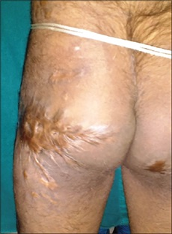
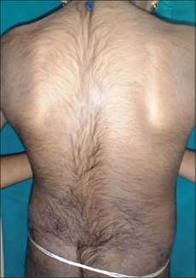
Cutaneous features: Tendency to form keloids, Pilomatricomas, Ingrown toe nails, Paronychia, Hypoplastic toe nails, Keratosis pilaris, Atopic eczema, Seborrheic dermatitis & Hirsutism.
Diagnosis is mainly on clinical grounds.
Management is mainly supportive.
Keloid on gluteal region
Hypertrichosis on the back
IADVL – AP
TEAM NELLORE
Ref: D Balikai et al. Rubinstein-Taybi Syndrome in a male child. IJPD 20(2): p 151-153, Apr – Jun 2019.

