Slide 1

DERMA PEARLS : SURGICAL PEARL -12
Efficacy of fractional CO₂ laser for improvement of limited mouth opening in systemic sclerosis
A frequent complication of systemic sclerosis is the limited mouth opening (LMO), a difficult-to-treat condition with only a few treatment options available
Fractional CO₂ laser was performed in the perioral area, under topical local anesthesia with F100 handpiece, Spot density of 81–100, in scattered mode, with Fluence of 8 mJ/cm², which is increased by 1–2 mJ/cm² at each session. 2-3 passes given without spot overlapping
Six laser sessions were performed at intervals of 4 weeks between sessions.
Patients were assessed by measurement of the IID (Interincisor distance) using a ruler and calculation of the mouth handicap in SSc (MHISS) scale at baseline, after three and six sessions, and 3 months after the last session.

Slide 2
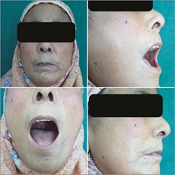
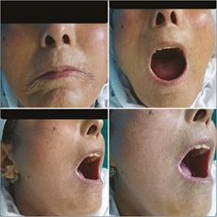
 | BASELINE | 3 MONTHS | 6 MONTHS | 9 MONTHS
MEAN IID | 2.56 | 2.95 | 3.54 | 3.63
MEAN MHISS | 24.7 | 17.9 | 12.3 | 11.5
Limited mouth opening and lip retraction at baseline
Increase in mouth opening, reduction in lip retraction, and radial furrowing after three sessions
IADVL-AP
Team Guntur
Dr.Rahul Kota
Further reading: Journal of Cutaneous and Aesthetic Surgery 15(4):p 387-393, October-December 2022

